Slide 1
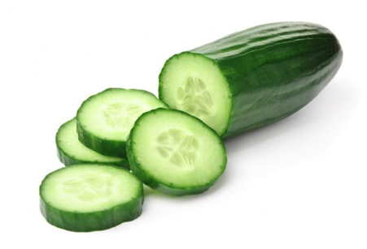
Gherkin 101
How and Why we use Gherkin

Slide 2

The Three Amigos
Successful BDD requires collaboration between the “3 Amigos”: Business, Development, Testing
Rhett Beattie (Business)
Lead BA for the CE Target State project
Developed and lead trainings on Gherkin for the CETS project team
Reviews all acceptance criteria of advance scrum team
Tim Taylor (Development)
Lead developer for the CE Target State project
Developed and lead trainings on Gherkin for the CETS project team
5 years experience working with Gherkin and Cucumber
Rahul Bandaru (Testing)
10 years experience in test automation
Piloted and delivered BDD testing framework for LDNG
Experience with Java based open source and commercially licensed tools

Slide 3

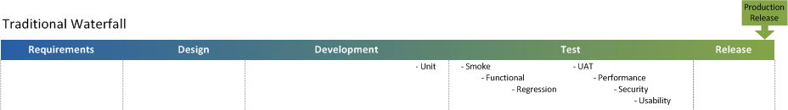
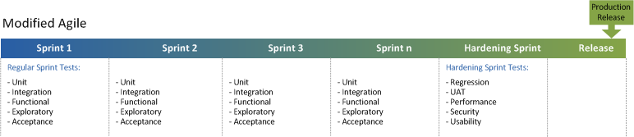
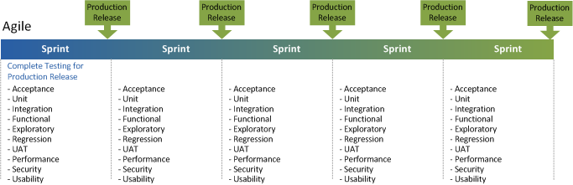
Value
Value
Reduced feedback loop “Fail Fast”
More frequent releases
Quicker value to users
Higher Quality

Slide 4
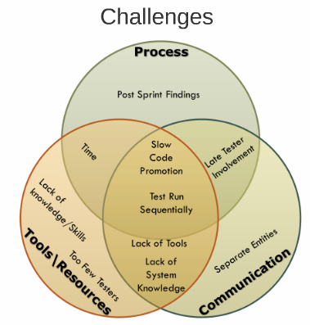
Challenges & Solutions
Challenges & Solutions
Lot to test in short amount of time
Solutions
Not just testers, whole team is responsible for testing
Fully integrated collaborative team (BA, QA, DEV)
Define tests early – “Shift Left”
Organize tests at the right level – “Shift Down”
Use right automation and collaboration tools

Slide 5
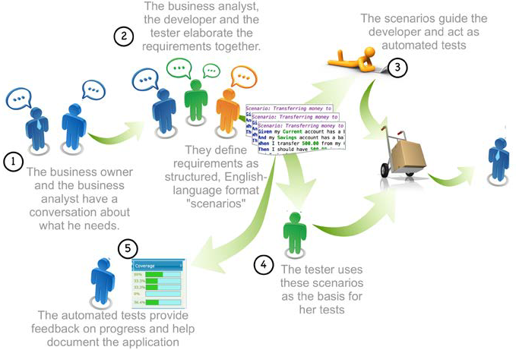
Shift Testing To Left
Shift Testing to the Left

Slide 6
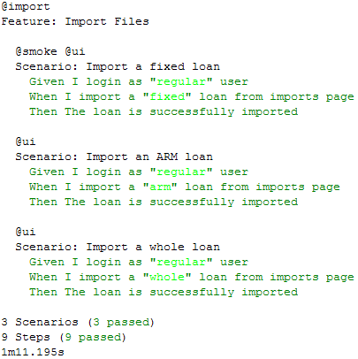
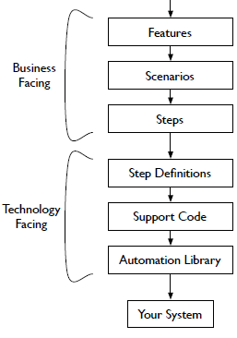
Executable Spec
Executable Specs
Executable Tests in Business Language (Gherkin)

Slide 7



BDD Relationships
Acceptance Criteria (Gherkin)
Step Definitions/Glue (Ruby)
Application Logic (Java)
Written using “Given, When, Then”
English sentences and phrases easily understood by the business
Written using Ruby code
Logic designed to pick up on key words “Given, When, Then” and execute appropriate part of the application
Written in Java (or any other application language)
Working code that Gherkin and Ruby steps are designed to test

Slide 8
What is Gherkin Language??
It is a business readable, domain specific language that lets you describe software’s behavior without detailing how that behavior is implemented
Gherkin serves two purposes:
Documentation
Automated Tests

Slide 9
Features
A feature is descriptive text of what is desired; what are you trying to accomplish?
A feature is a user story, with associated scenarios (acceptance criteria).
That’s why acceptance criteria are grouped into “.feature files!”
Feature: Initiate New Agreement
As a Deal Manager, I want to be able to initiate a new agreement and track it throughout the life of the agreement

Slide 10
Scenarios
A scenario will determine a business situation (usually reflected in the title)
Features can have one or more scenarios
Feature: Initiate New Agreement
As a Deal Manager, I want to be able to initiate a new agreement and track it throughout the life of the agreement
Scenario: Deal Manager Successfully Creates Agreement
Given I am able to log into the CE system
And I have rights to enter an agreement
And I have rights to save an agreement
When I save the agreement
Then I see the agreement in the system

Slide 11
Features vs. Scenarios
Features (user stories) describe business functionality, and are written from the users’ perspective. They leave the system out of it!
A scenario elaborates on a feature and is written using system specifications
Feature: Calculator
As a BA, I want to be able to add two numbers together
Scenario: Add two numbers
Given that I have input 2+2
When the calculator run
Then the output is 4

Slide 12
Givens
A “given” step puts the system in a known state before the user starts interacting with the system
Avoid talking about user interactions in givens
Example: Authenticated a user
Given that I am logged in as “Taylor”
Example: Setup a database
Given that the database is clean
Example: Editing an agreement
Given that Agreement 1234 exists in production

Slide 13
Whens
The purpose of “when” steps is to describe the key action the user performs
Example: Interact with a page
When I am on “agreement screen”
When I fill “username” with “Taylor”
When I fill “password” with “123456”
When I press “Login”

Slide 14
Thens
The “then” statements observe outcomes
Observations should be related to the business value/benefits in your feature description
Observation would expect the output of the system, and not something burred deep inside it
Example: Logging in
When I login as “Taylor”
Then I see the agreements home page

Slide 15
Breakout Session (30 Minutes)

Slide 16
Gherkin Uses Examples
Gherkin is written using examples that can be passed into tests
Example: As a BA, I want to be able to enter in the basic minimal information so that I can track a credit risk sharing agreement in the CETS system
Scenario: Successfully save agreement
Given the agreement name is “CAS Deal Q1 2015”
And the description is null
And the agreement name “CAS Deal Q1 2015” does not already exist in the system
And the maximum agreement ID in the system is 214
When I save the agreement
Then the agreement is saved
And the agreement name is “CAS Deal Q1 2015”
And the description is null
And the agreement ID is 215

Slide 17
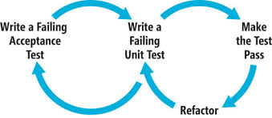
Built on Failing Tests
New acceptance criteria must reflect tests that will fail until new code is written
Two user stories cannot have the same acceptance criteria… or else the second represents no new functionality!

Slide 18



Step Definition States
Undefined – Gherkin acceptance criteria with no corresponding step definition
Pending – Gherkin acceptance criteria with corresponding step definition in a “pending” state (indicates it’s still being worked on)
Failed – Gherkin acceptance criteria with corresponding step definition, but no application logic to make the step pass (This is a good thing! It’s how we drive our development)
Passed – Gherkin acceptance criteria with corresponding step definition, and application logic allowing step to pass

Slide 19
Based on App States
“Given, When, Then” statements must be written based on application states
Example: As a bank customer, I want to be able to withdraw funds from my checking account
Scenario: Successfully withdraw funds (Not Ideal)
Given the customer wants to withdraw $20
When the customer selects “withdraw”
Then the ATM disburses $20
Application can’t know when a customer wants to withdraw
Scenario: Successfully withdraw funds
Given the customer has entered their Bank of America check card
And the customer has entered Pin 1234
And the customer enters a withdrawal amount of $20
When the customer selects “withdraw”
Then the customer receives $20 from the ATM machine

Slide 20
Breakout Session - Amazon Example (90 Minutes)

Slide 21
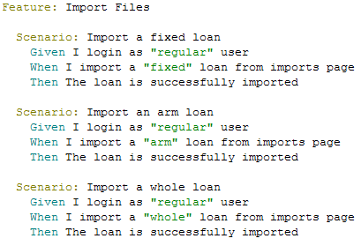
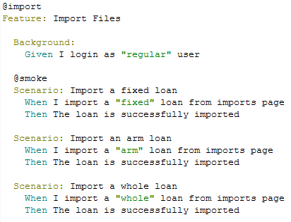
Background
A background allows you to add some context to all scenarios in a single feature
The background is run before each scenario

Slide 22
Tags
Tags are a great way to organize your features and scenarios
A scenario or feature can have as many tags as you like, just separate them with spaces:
@login
Feature: Login authentication and authorization
@important
Scenario: Missing authorization
Scenario: Authentication valid
@login @authentication @authorization
Feature: Login authentication and authorization

Slide 23
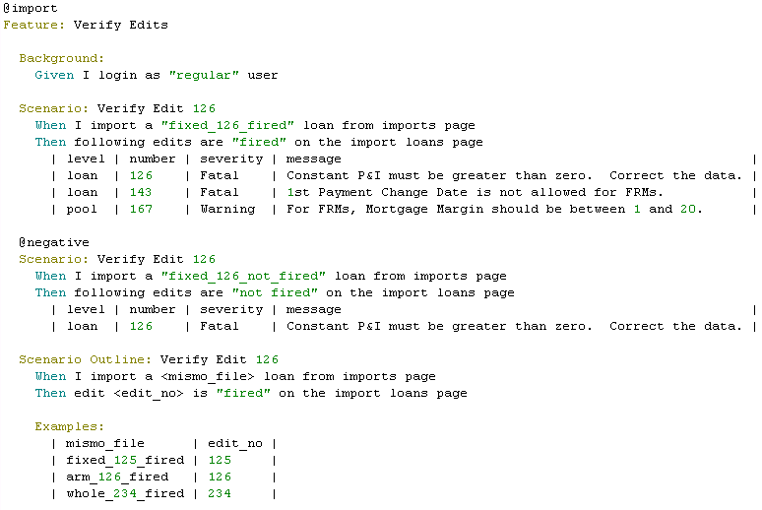
Data Tables and Templates
Data Tables and Templates

